Slide 1

SIGN LANGUAGE RECOGNITION USING PYTHON
NAME: TAPASWINI HALDAR, SELINA NAYAK, STUTI PATTNAIK
REDG NO: 2112100041, 2001106516,2001106520
BRANCH: INFORMATION TECHNOLOGY
SEMESTER: 7
GROUP : 17
Guided by : MR. DEBI PRASAD MISHRA

Slide 2
INTRODUCTION
Sign languages vary throughout the world.
There are around 300 different sign languages used across various parts of the world.
This is because sign languages were developed naturally by people belonging to different ethnic groups.
This system makes it easy for the specially challenged people to communicate effectively with the rest of the world.
This could enhance their abilities and make them realize that they can do better in life. The proposed system performs Gesture to Text conversion .

Slide 3
PROBLEM STATEMENT:
The desire of computer based solution is significant in this age of technology for deaf people . however ,researchers have been working on the problem for quite some time, and the results are promising. Although interesting technology for voice recognition are becoming available there is currently no commercial solution for sign recognition in market.
The gesture is a vital and meaningful mode of communication . So here is a computer based method for regular people to understand what differently abled individual is trying to say.
In this system the user will perform the hand gestures by turning on the camera and the system will detect the sign and display it to the user.

Slide 4
Literature survey:
A mobile application of American sign language translation via image processing algorithms
AUTHORS: cheok ming jin, zaid omar, mohameddue to the relative lack of pervasive sign language usage within our society, deaf and other verbally- challenged people tend to face difficulty in communicating on a daily basis. Our study thus aims to provide research into a sign language translator applied on the smartphone platform, due to its portability and ease of use.
.Real-time indian sign language (isl)
Authors: karthik shenoy, tejas dastane, varun rao, devendra vyavaharkar.This paper presents a system which can recognise hand poses & gestures from the indian sign language (ISL) in real-time using grid-based features this system attempts to bridge the communication gap between the hearing and speech impaired and the rest of the society. The existing solutions either provide relatively low accuracy or do not work in real-time.

Slide 5
PROPOSED SYSTEM
The sign language detection using ML project proposes an intelligent solution to address the limitations of the existing system by implementing machine learning algorithms, the system can recognize hand gestures from video input, allowing for immediate and accurate interpretation.
The proposed system will utilize image processing techniques to extract relevant features from the hand gestures, which will then be fed into a machine learning model for classification. This enables the system to provide real-time interpretation of sign language, promoting inclusive communication.

Slide 6
COMPONENTS OF SIGN LANGUAGE RECOGNITION
Data collection: A dataset of sign language gestures is collected, including various hand shapes.
Preprocessing: the collected data is pre-processed to enhance the quality, remove noise, and extract relevant features.
Model training: machine learning models, i.E. Convolutional neural networks (cnns) is trained on the pre-processed data to learn the mapping between input gestures and their corresponding meanings.
Real-time recognition: the trained model is deployed in a real-time environment, where it takes video input and performs gesture recognition on the fly.

Slide 7
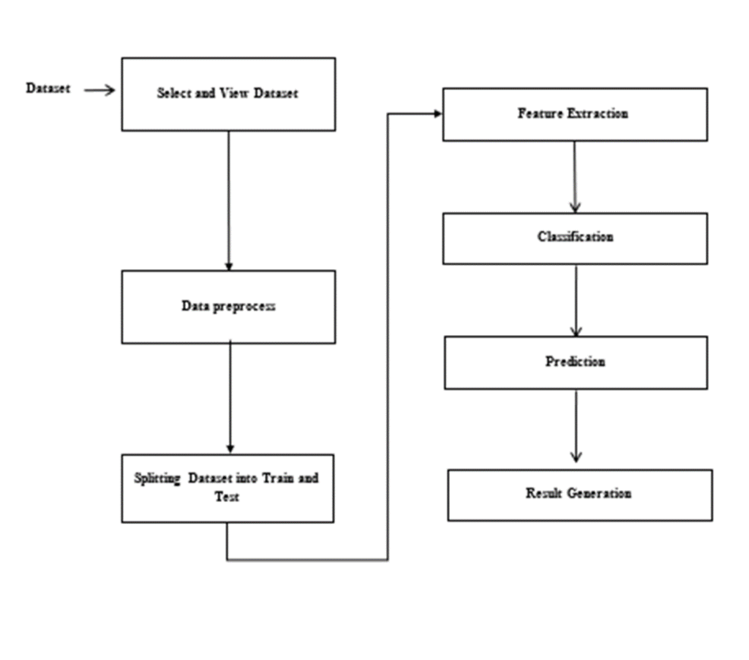
SYSTEM DESIGN:

Slide 8
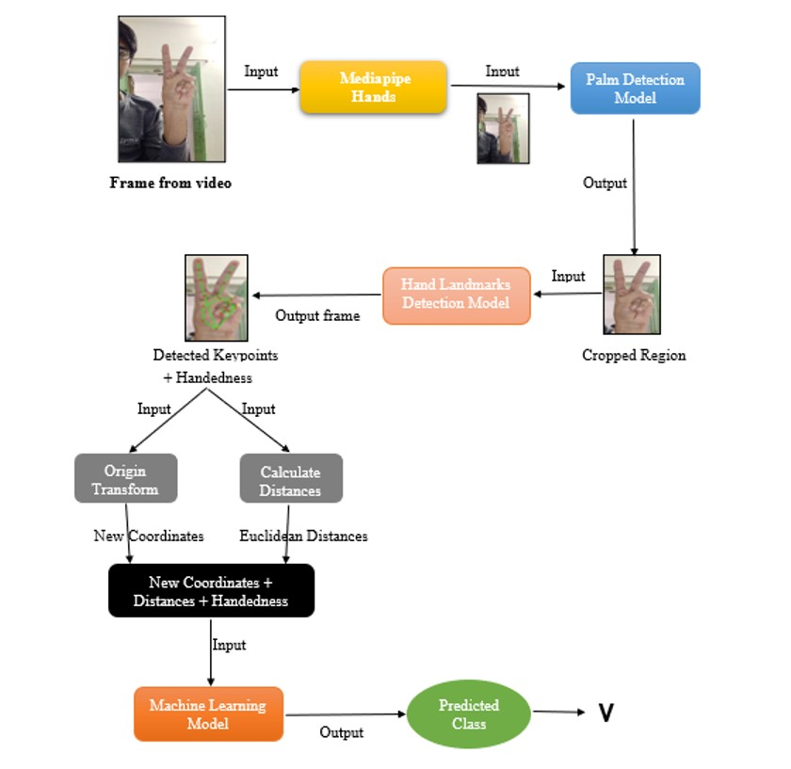
SIGN LANGUAGE RECOGNITION SYSTEM:

Slide 9
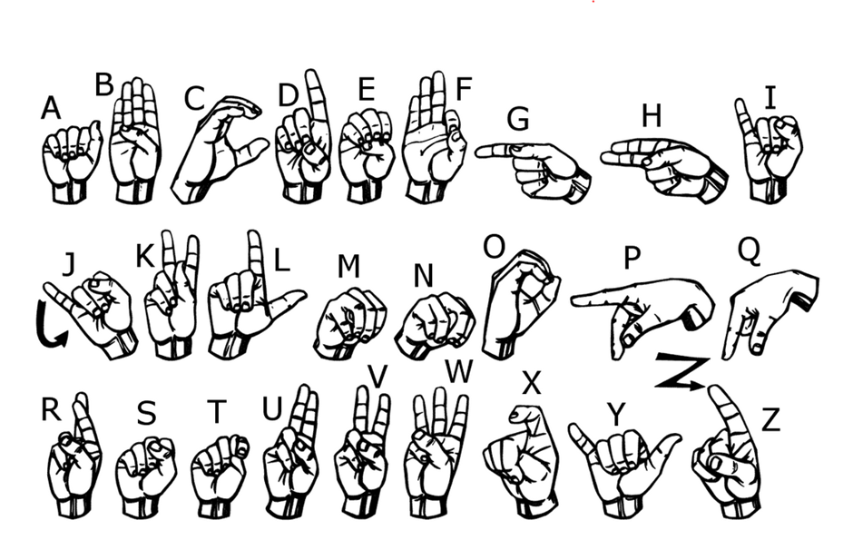
Input design(sign languages)

Slide 10
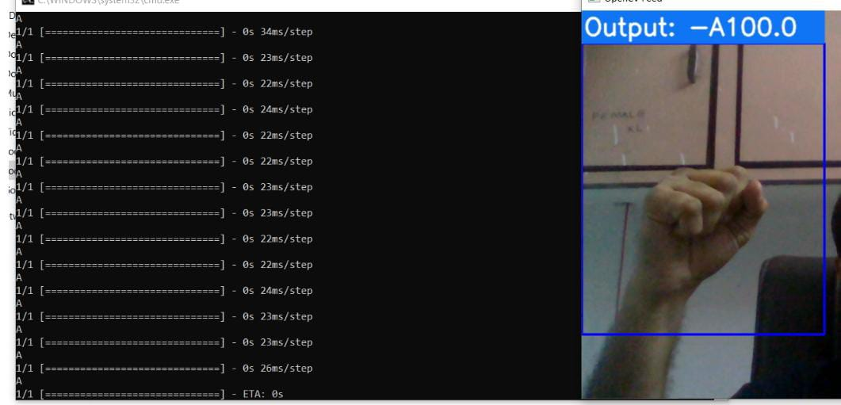
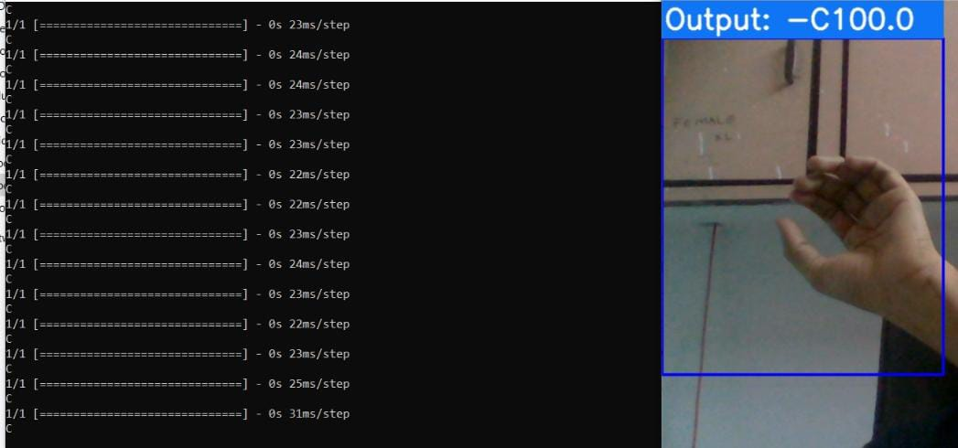
RESULTS

Slide 11
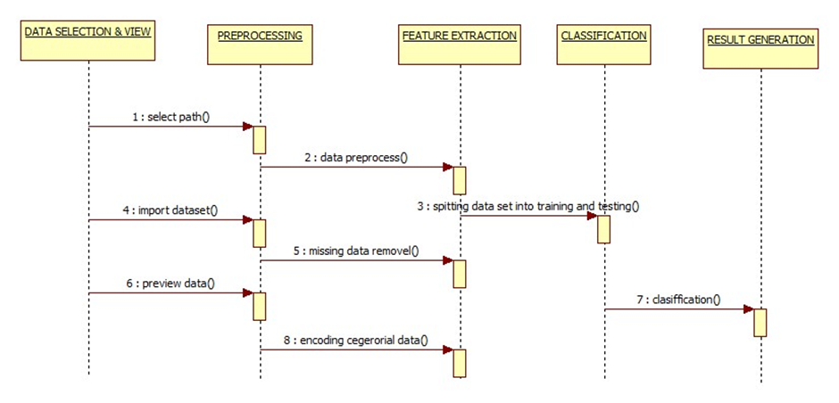
SEQUENCE DIAGRAM:
A sequence diagram in unified modeling language (UML) is a kind of interaction diagram that shows how processes operate with one another and in what order.

Slide 12
MODULES:
1. Hand detection and tracking 2. Feature extraction 3. Machine learning classification 4. Real-time interpretation 5. User interface

Slide 13
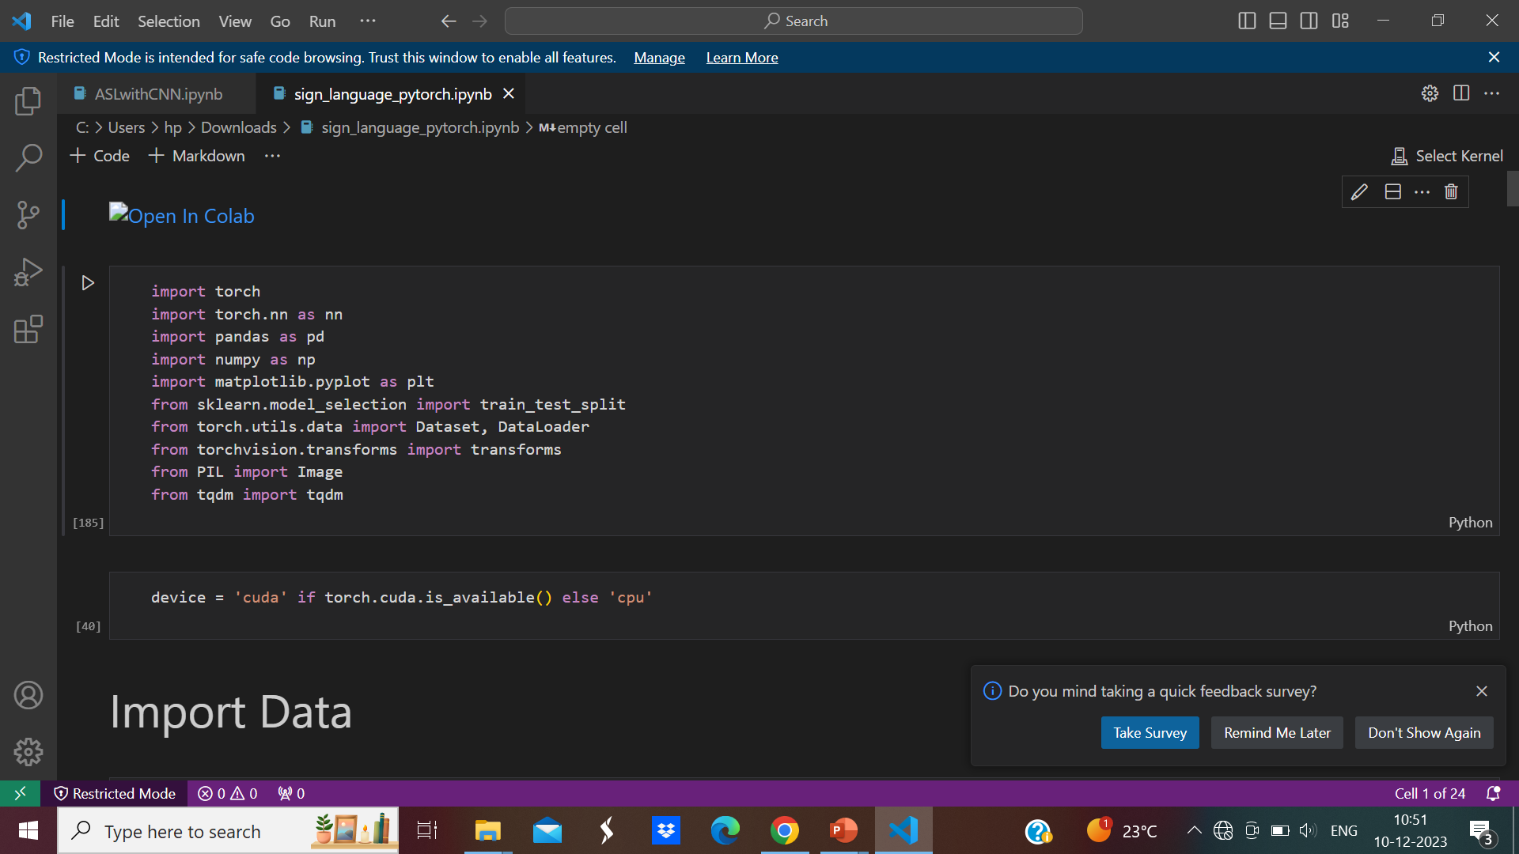
DATASET COLLECTION:
Datset is downloaded from kaggle.(Sign language mnist)

Slide 14
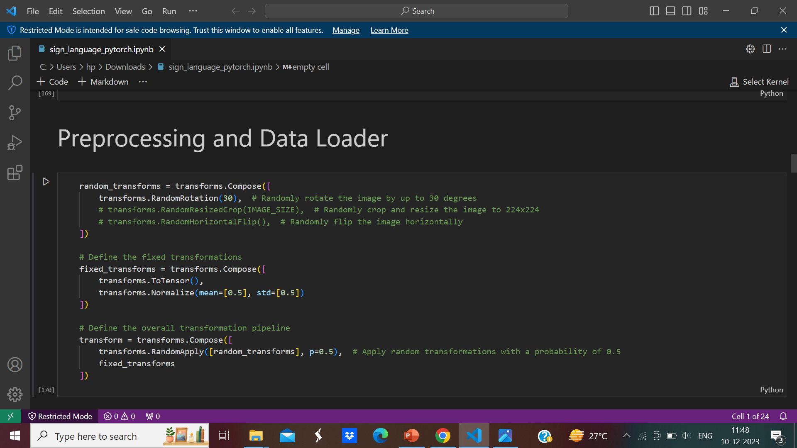
DATA PREPROCESSING

Slide 15
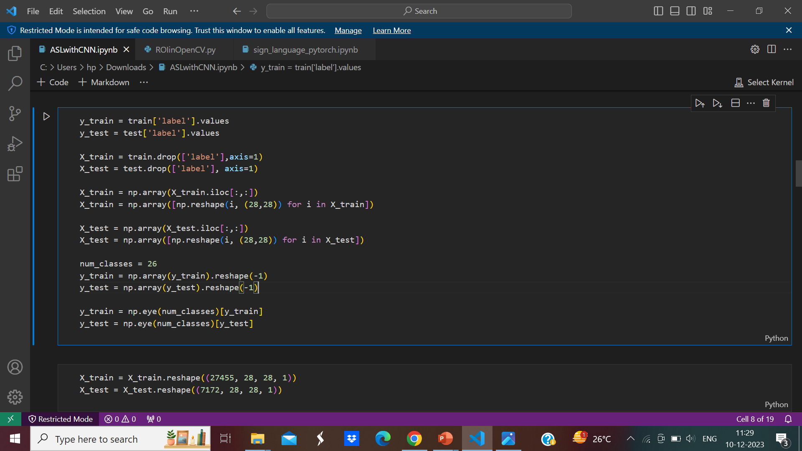
Training dataset

Slide 16
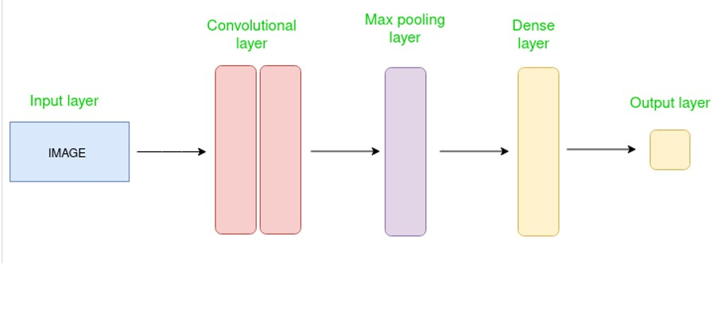
ALGORITHM:
CNN Convolutional Neural Network:
Convolutional neural network consists of multiple layers like the input layer, convolutional layer, pooling layer, and fully connected layers.

Slide 17
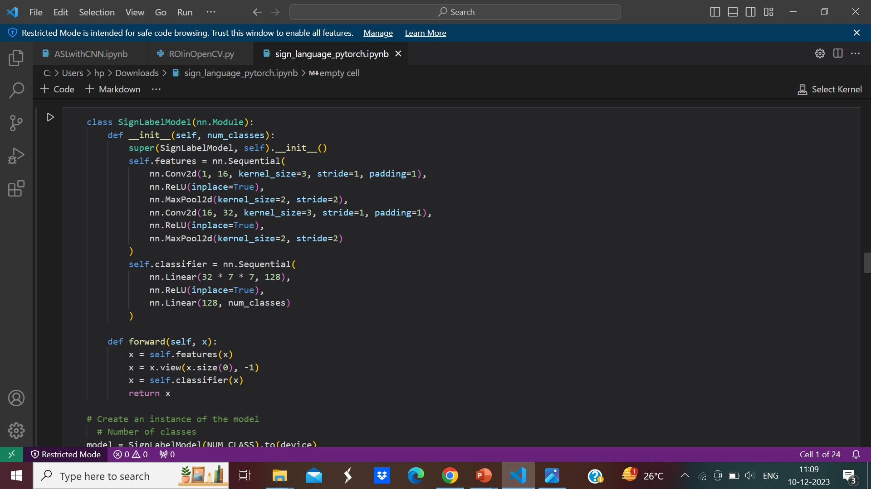
MODEL BUILDING

Slide 18
REQUIREMENT SPECIFICATIONS:
Functional requirements:
Graphical user interface with the user.
Software requirements : for developing the application the following are the software requirements:
1. Python
Operating systems supported:
1. Windows 10 64 bit OS
Technologies and languages used to develop:
1. Python
Debugger and emulator:
Any browser (particularly chrome)

Slide 19
Future work
Optimise the model for better accuracy and real time performance
Combining video and depth data for a more comprehensive understanding of sign language gestures.
Augmenting dataset with variations in lighting conditions, backgrounds, and hand orientations to improve the robustness of your model.
Implementing techniques for continuous learning to adapt the model to new signs and variations over time.

Slide 20
REFERENCES
[1] Cheok ming jin, zaid omar, mohamed hisham jaward, ”A mobile application of american Sign language translation via image processing algorithms”, in IEEE region 10 symposium, on Ieeeexplore, 2016.
[2] mr. Sanket kadam, mr. Aakash ghodkeprof. Sumitra sadhukhan, ”hand gesture recognition Software based on ISL”, IEEE xplore, 20 june 2019.
[3] Kartik shenoy, tejas dastane, varun rao, devendra vyavaharkar, ” real-time indian sign Language (isl) recognition”, ieee xplore: 18 october 2018.
[4] T raghuveera, r deepthi, r mangalashri and r akshaya, “a depth based isl recognition Using microsoft kinect”, sciencedirect, 2018.
[5] Muthu mariappan h, dr gomathi v, “real time recognition of isl”, ieee xplore: 10 october 2019.

